Slide 1
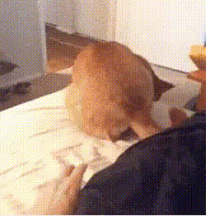
Cat and Dog Classification
By: Susan Nunez, Madison Yonash, and Claire Robinson

Slide 2
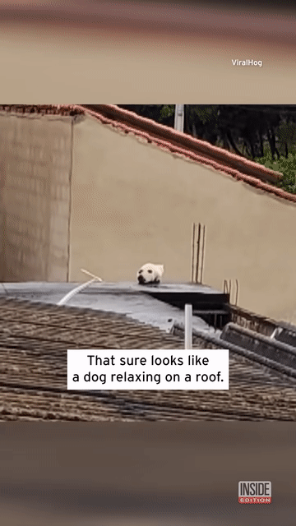
Introduction
Image classification using neural networks (NN) allows for the automatic categorization of visual data such as photos or videos
Supervised learning with the goal of labeling the test image
Specifically convolutional neural networks (CNN) are good at learning features such as edges, textures, and shapes

Slide 3
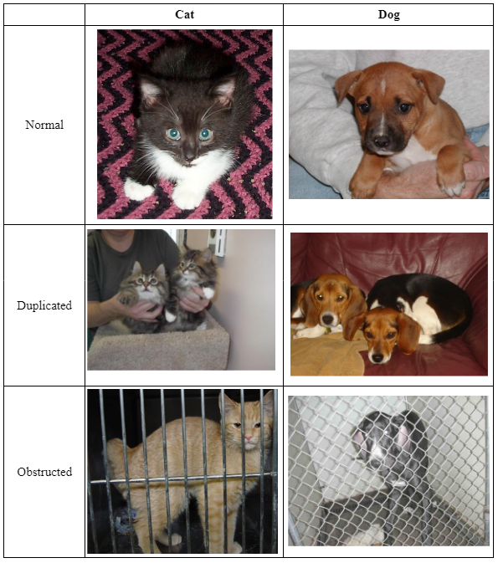
Data
This data set includes 25,000 images that are a subset of three million annotated images compiled by Petfinder.com and Microsoft
There are 12,500 images for each class
The dataset is not split into training and testing sets, but separated based on if they are a cat or dog
Many of the images have additional noise or obstructions in the images
The dataset is not uniform

Slide 4
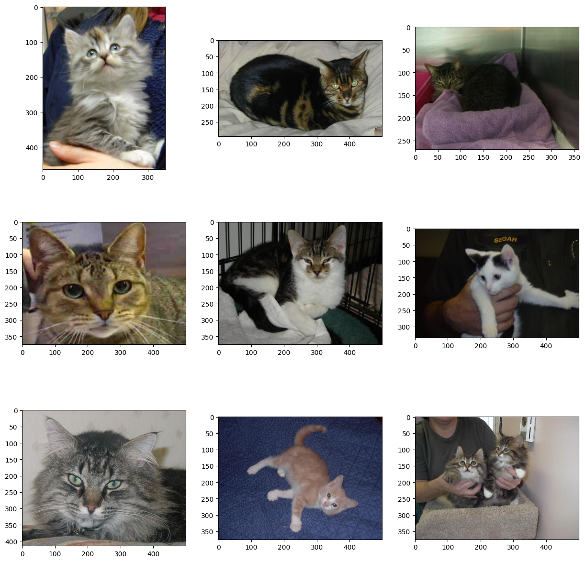
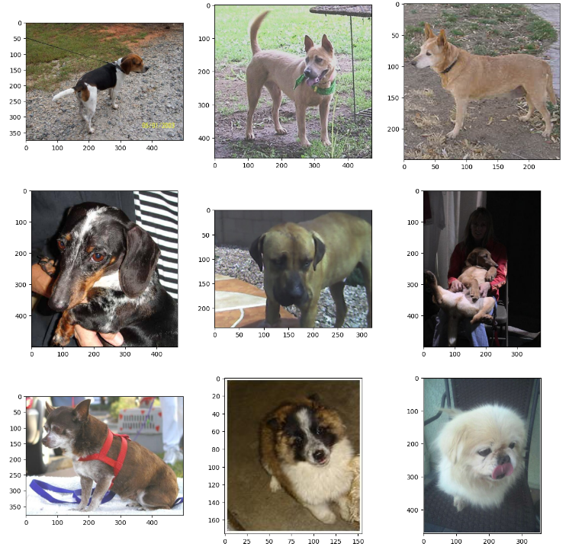
EDA- Random sampling of photos

Slide 5
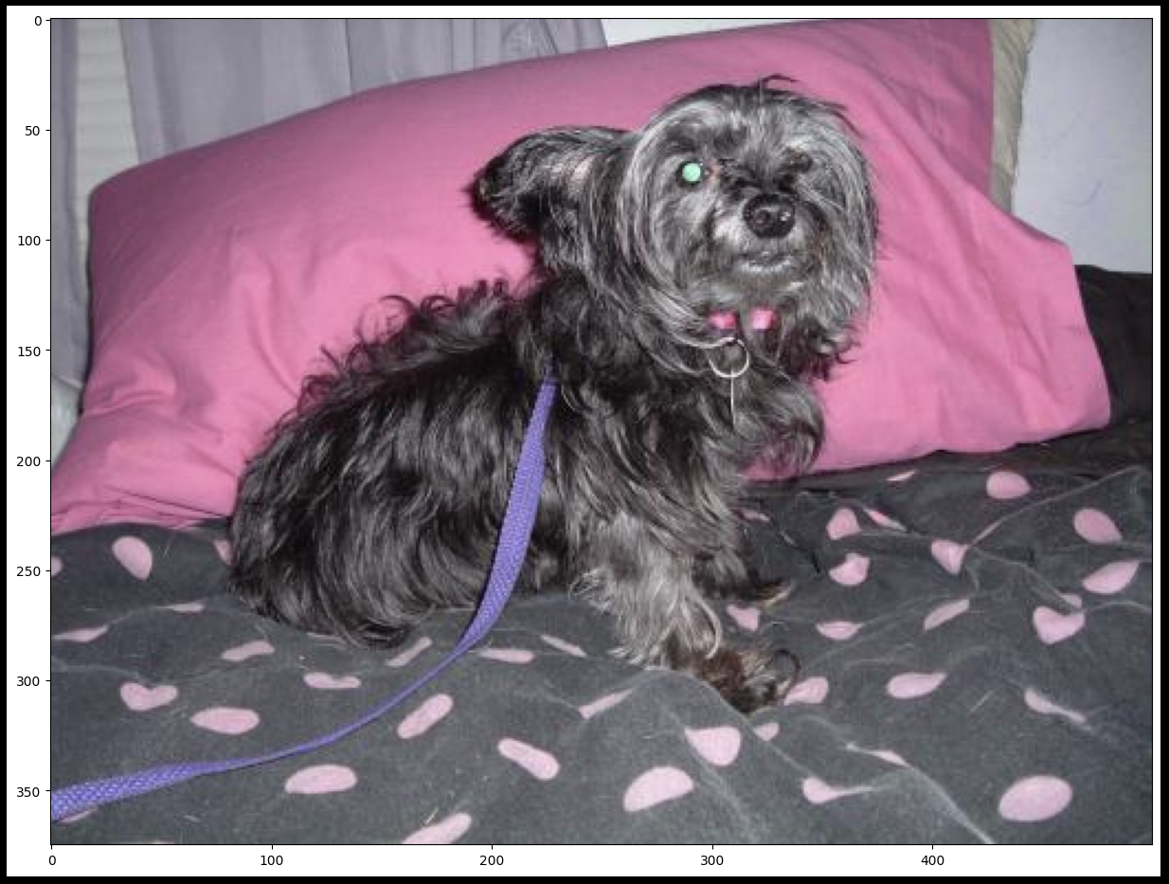
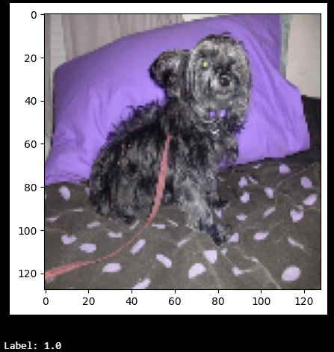
Data preprocessing
Normalize Colors
Dividing the pixel colors by 255
Common technique when dealing with images in Red, Green, and Blue color space
Range in color intensity from 0-255 but will be 0-1 after normalization
Resize Images
Change all pictures to be 128x128 pixels
Add Data Labels
0 for cats and 1 for dogs
BEFORE:
AFTER:

Slide 6
Model
Layers | Explanation
Convolutional | Extract features such as edges, texture, and patterns
Max Pooling | Reduce dimensions by selecting max value from feature map regions
Batch Normalization | Normalize input from previous layer through recentering or rescaling (makes NN more stable and faster)
Flatten | Flatten input to 1D vector in order to put through Dense layers (convolutional to dense)
Dense | A layer of neurons that connects to other layers of neurons (Activation Function: ReLU aka Rectified Linear Unit)
Dropout | Randomly sets inputs to zero- aka it randomly drops neurons (helps prevent overfitting)
Used pre-built architecture from Abdullah Al Asif on Kaggle
The neural network roughly follows an AlexNet architecture
A type of CNN architecture that in 2012 won the LSVRC (Large Scale Visual Recognition Challenge) by a large margin
Roughly 84% accuracy at 100 epochs

Slide 7
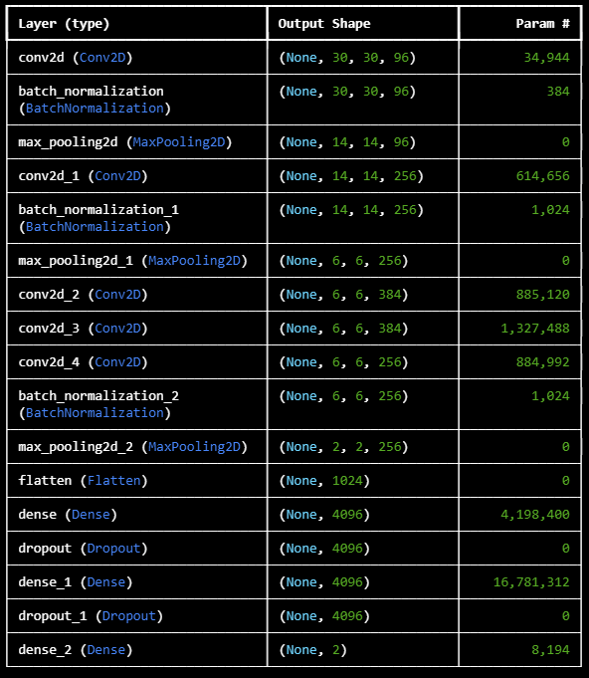
Model
Totals:
Convolutional: 5 layers
Batch Normalization: 3 layers
Used after Convolutional
Max Pooling: 3 layers
Used after Convolutional
Flatten: 1 layer
Dense: 3 layers
Dropout: 2 layers

Slide 8
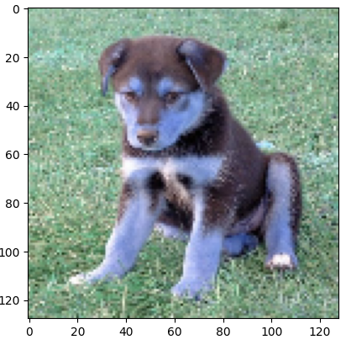
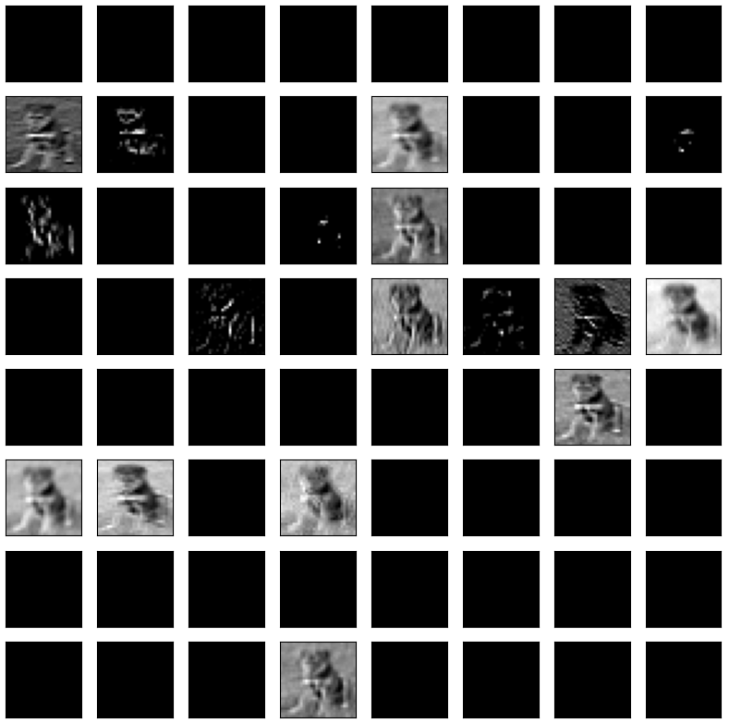
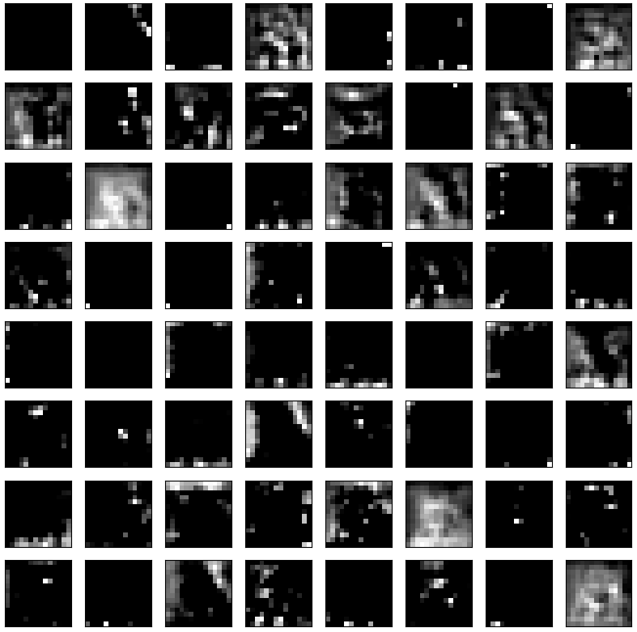
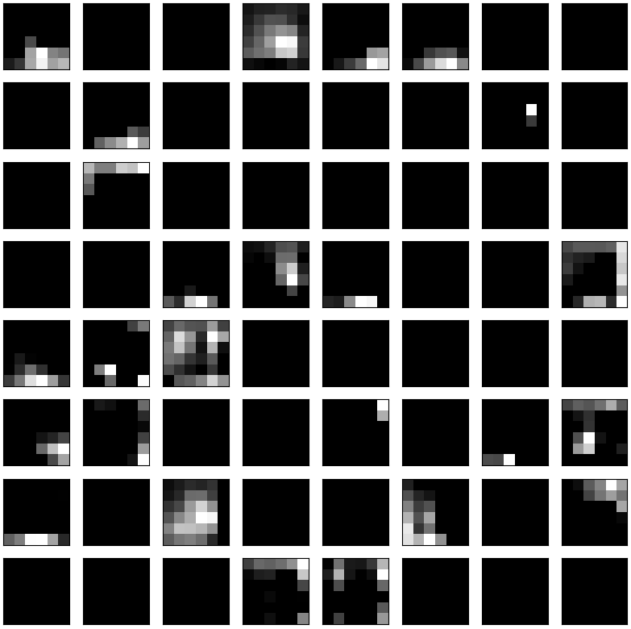
Feature maps
1st Convolutional Layer
2nd Convolutional Layer
5th Convolutional Layer

Slide 9
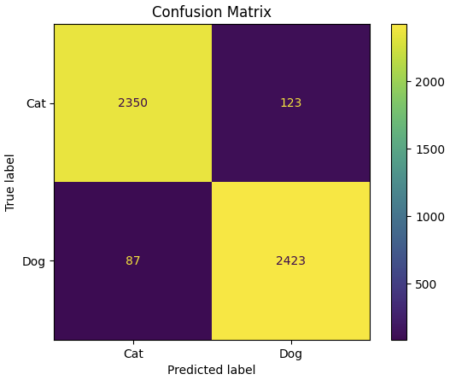
Model Results
Accuracy: 84.06%
Loss: 1.5003
Epochs: 100
Note: the original model had 1,000 epochs and achieved a higher accuracy
On desktop it took roughly ~2minutes per epoch or 3.33 hours per train. Therefore, 1,000 was not feasible as it would take us roughly 1.3 days to run :(

Slide 10
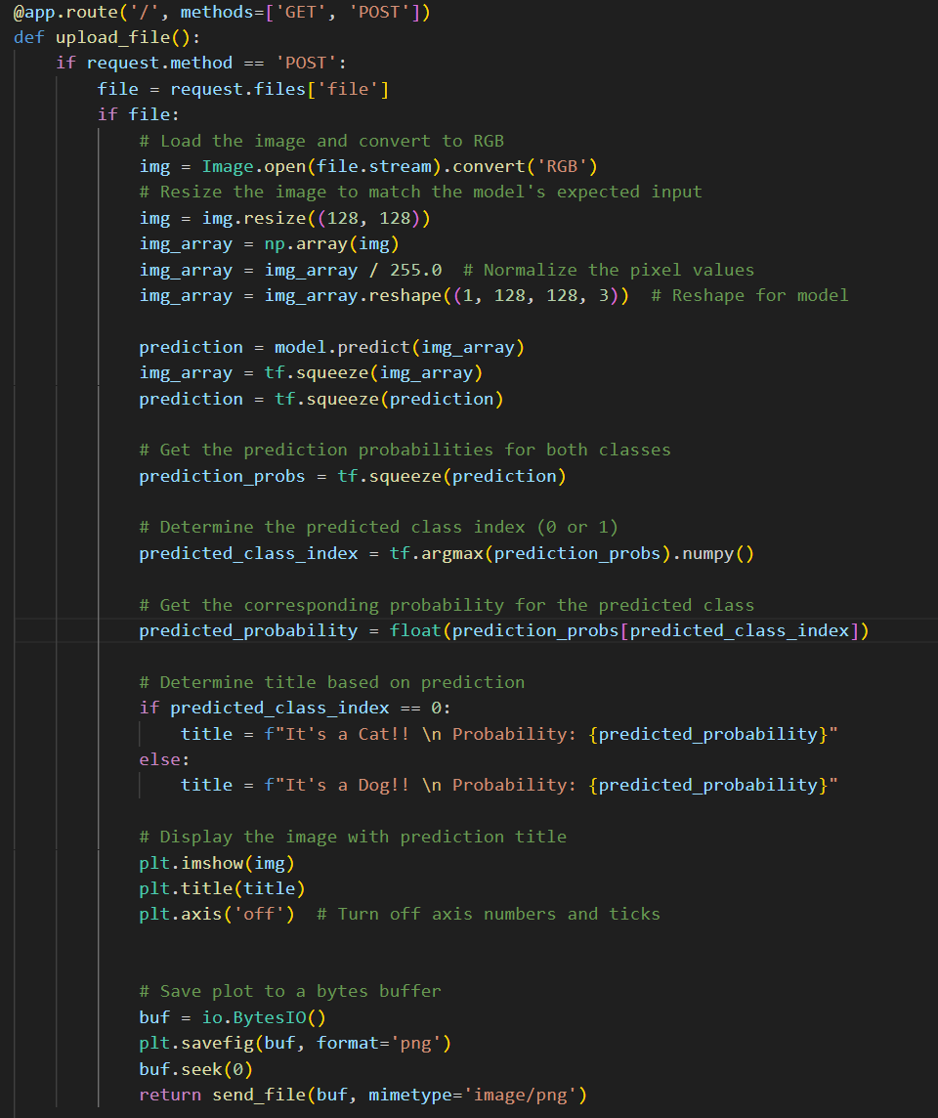
Web App, using flask
User uploads image
Image undergoes preprocessing
Image is tested using model
Image is classified
Result, photo, and probability are output to user

Slide 11
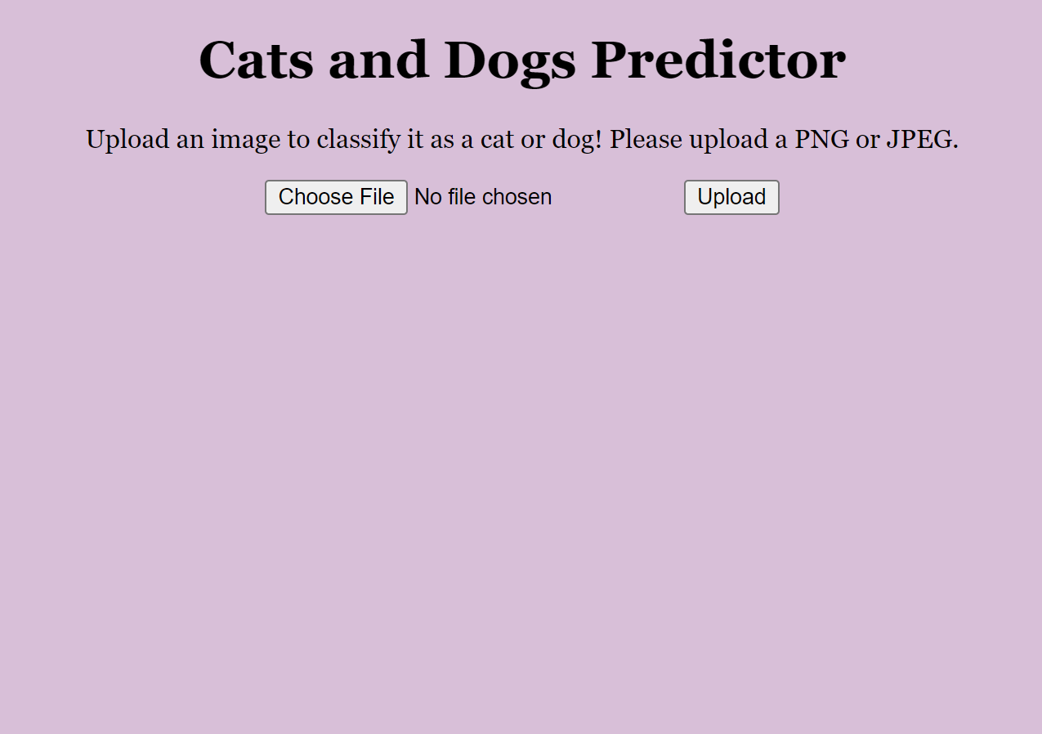
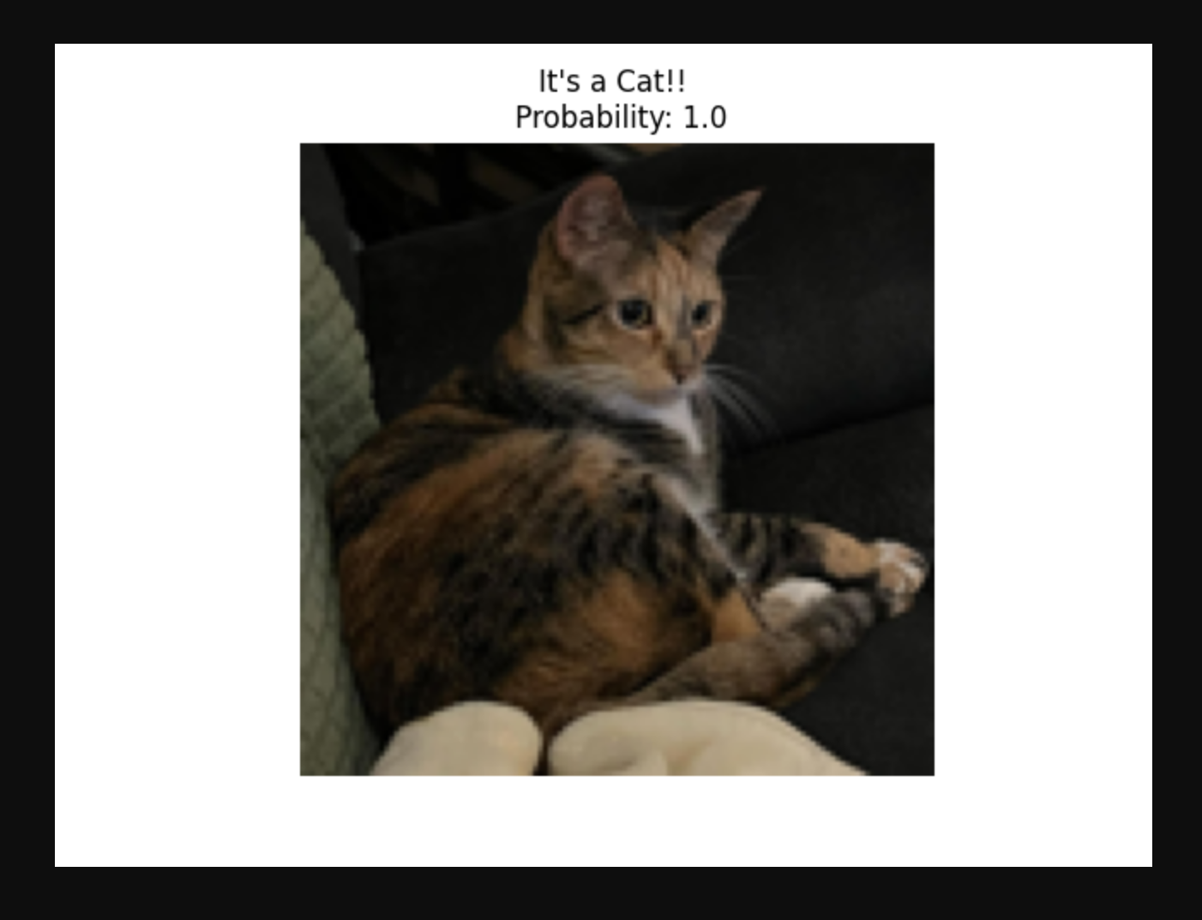
Web App

Slide 12
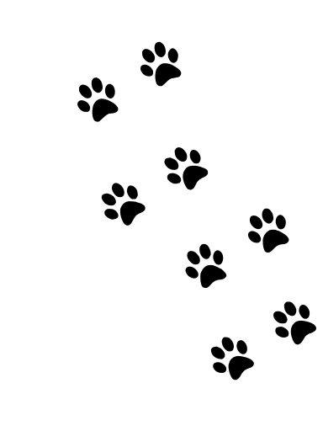




Demonstration

Slide 13
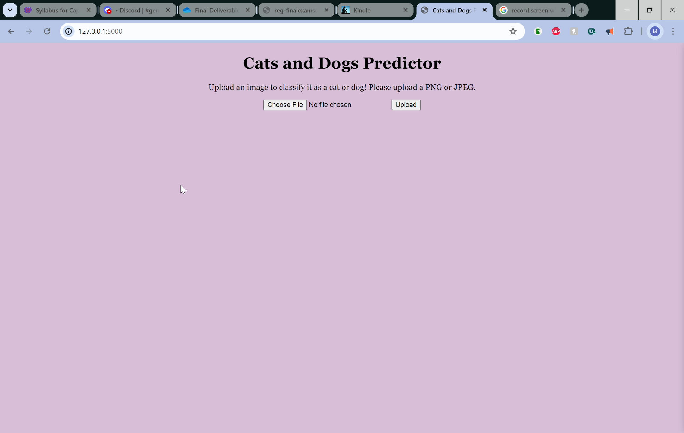

Slide 14
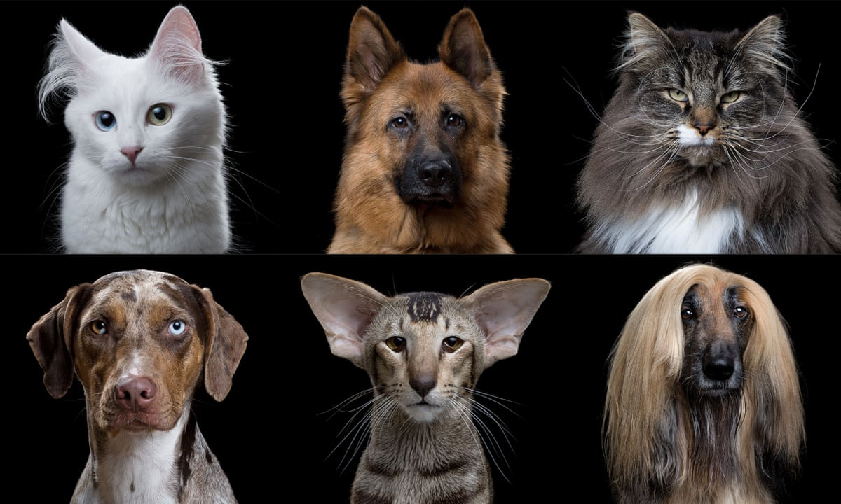
Future works
Try different kinds of models and neural networks to compare the results
Continue to improve upon and adjust the current model
Add in more data as this is only a SMALL subset of the full dataset
Explore more image preprocessing techniques to see if it works better with the model

Slide 15
Works Cited
ASIF , A. A. (2023). Exploring CNN models: Cats and dogs classification. https://www.kaggle.com/code/asif00/exploring-cnn-models-cats-and-dogs-classification
An example notebook of how to make an image classifier for cats and dogs found on kaggle. This notebook also discusses the use of AlexNet models for image classification and is what we are basing the preliminary model off of.
Acsany, Philipp. (2023, December 13). Build a Scalable Flask Web Project From Scratch. Real Python. https://realpython.com/flask-project/
Information on using Flask for web app development.
Brownlee, J. (2021, December 7). How to classify photos of dogs and cats (with 97% accuracy). MachineLearningMastery.com. https://machinelearningmastery.com/how-to-develop-a-convolutional-neural-network-to-classify-photos-of-dogs-and-cats/
An example using a similar cat and dog dataset of photos to build neural networks for classification using Python. It will be beneficial to reference in terms of how to start the modeling process and look for different ways we can make the project our own.
Callens, A. (n.d.). Shiny_Classifier: Shiny application to manually classify images by pushing buttons. GitHub. https://github.com/AurelienCallens/Shiny_Classifier
Gives an example of how to create a Shiny app for a classification task, will be useful in determining the UI we are creating and how to implement the server versus UI.
Deploying a shiny app with a tensorflow model. TensorFlow for R. (n.d.). https://tensorflow.rstudio.com/guides/deploy/shiny.html
This is an example of implementing Tensorflow into a Shiny App. It can be useful because it uses a Keras API as the model. It also provides another example of creating a Shiny App and other advanced models that can be applied into the app.
Lendio, L. (2023, September 6). Cats vs dogs image classification model. Kaggle. https://www.kaggle.com/code/orensa/cats-vs-dogs-image-classification-model
An image classification model that shows the different steps when creating and implementing the model. This was an entry in the Kaggle competition that is where we are getting our data set.
Padhiar, K. (2020, May 1). Cat vs dog dataset. Kaggle. https://www.kaggle.com/datasets/karakaggle/kaggle-cat-vs-dog-dataset
This is the dataset that contains the cat and dog photos that we will using for model training.

Slide 16
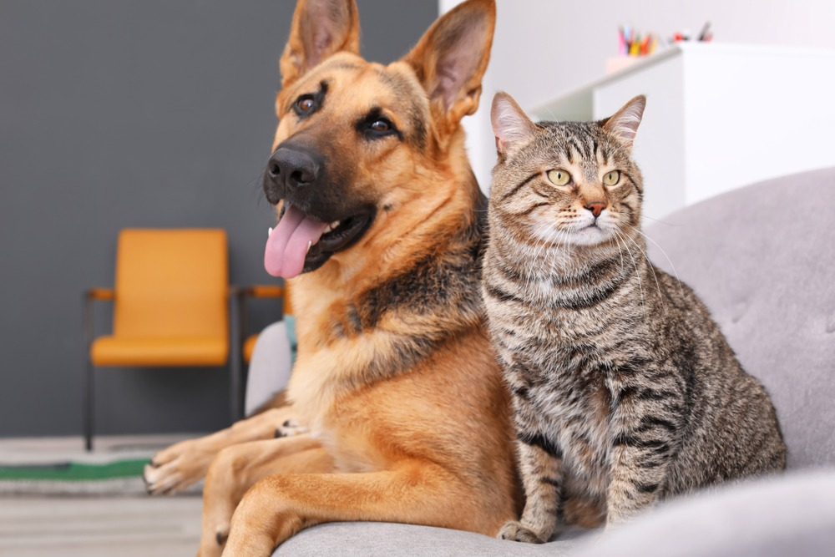
Thank you! Questions?

